Slide 1

Exploring Medical Malpractice Claims Rise
Bisma Jalili
Enaam Hamad
Shaza Abdalsalam
Zainab Arif

Slide 2

Introduction:
This introduction highlights the critical relationship between the healthcare system and medical malpractice, emphasizing their impact on patient safety and healthcare quality. It explains that medical malpractice claims involve legal actions taken by patients or their families seeking compensation for harm due to negligence. The outcomes of these claims are influenced by various factors, including legal representation, patient demographics, and medical specialty.
Our project's objective is to evaluate the patient experience in medical malpractice claims, particularly focusing on the role of medical insurance, also will analyze a dataset of 79,210 medical malpractice claim payments, with figures expressed in thousands for clarity and scale.

Slide 3

Project Description:
According to a recent study published in the US News and World Report, the cost of medical malpractice in the United States is $55.6 billion a year, which is 2.4 percent of annual health-care spending. Another 2011 study published in the New England Journal of Medicine revealed that annually, during the period 1991 to 2005, 7.4% of all physicians licensed in the US had a malpractice claim. These staggering numbers not only contribute to the high cost of health care, but the size of successful malpractice claims also contributes to high premiums for medical malpractice insurance. The data set contains information about the last 79,210 claim payments made.

Slide 4
Data Information:
The data set contains information about the last 79,210 claim payments made:
Amount: Amount of the claim payment in dollars
Severity: The severity rating of damage to the patient, from 1 (emotional trauma) to 9 (death)
Age: Age of the claimant in years
Private Attorney: Whether the claimant was represented by a private attorney
Marital Status: Marital status of the claimant
Specialty: Specialty of the physician involved in the lawsuit
Insurance: Type of medical insurance carried by the patient
Gender: Patient Gender

Slide 5
Key Research Questions
Are individuals represented by private attorneys more likely to receive larger settlements or judgments in medical malpractice?
Is the age of the patient a factor influencing the size of the claim?
For which specialty is malpractice insurance most costly?
What impact does the choice of the insurance have on the claim amount?

Slide 6
Methodology and Data Processing details:
1. Data Gathering and preprocessing:
Gathered the medical malpractice claim payments dataset and conducted preprocessing tasks to address missing value and inconsistencies using pandas and numpy functions.

Slide 7
2. Performed EDA to gain insights into data distributions and to identify patterns, relationships, and outliers within the dataset, and that through Python libraries such as Pandas and Numpy.
3. Statistical Analysis: Utilized statistical tests such as: ttest_ind, scipy.stats, and The ANOVA test; as well as regression analysis to assess the impact of various factors on claim outcomes, including age, the presence of a private attorney, and insurance type.

Slide 8
4. Data Visualization: Created visualizations to effectively communicate key findings and trends, enhancing the understanding of the dataset by using matplotlib.pyplot and seaborn including scatterplots, bar charts, and box plots.
5. Summary and Recommendations: Summarized the findings and provided actionable recommendations for healthcare and insurance stakeholders based on the analysis.
6. Documentation: Maintain clear documentation and generate a comprehensive report to convey the results and insights of the analysis.

Slide 9
Key Questions and answers
1. Are individuals represented by private attorneys more likely to receive larger settlements or judgments in medical malpractice?
- The analysis findings point to a significant variance in average compensation between claims that involve private attorneys than those that don’t. In this specific context, it has become evident and supported by strong statistical evidence that retaining a private attorney significantly influences the amount received in claims than those who don’t.

Slide 10
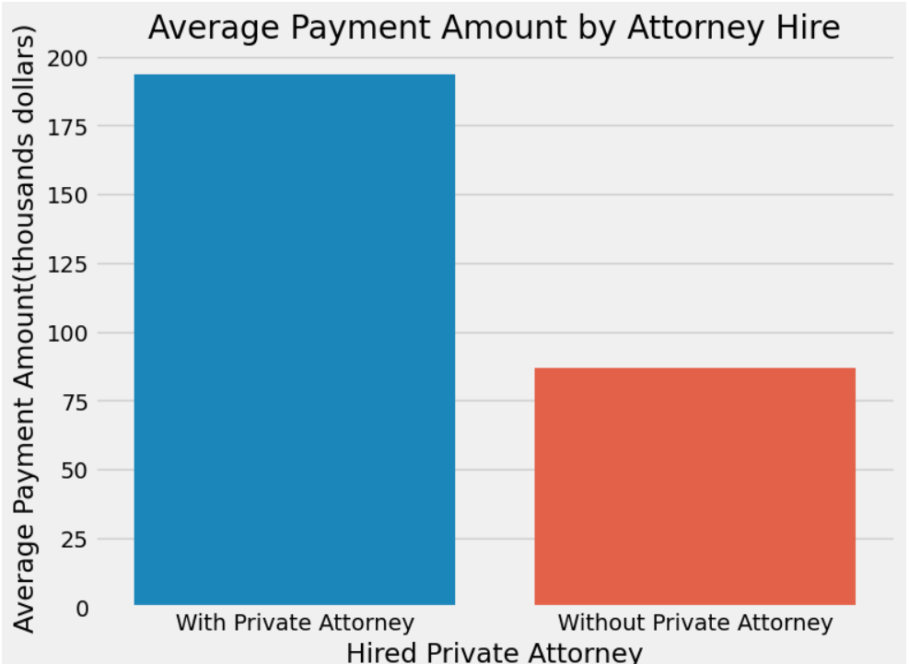
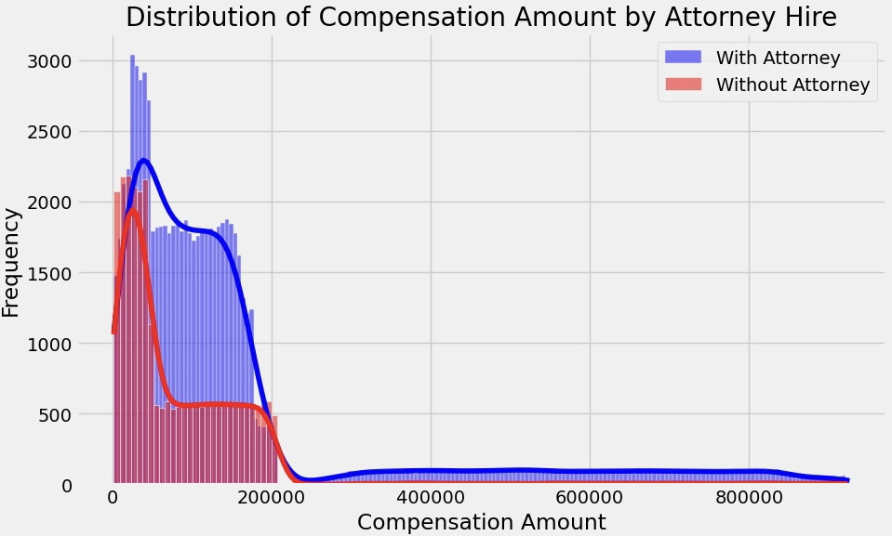

Slide 11
2. Is the age of the patient a factor influencing the size of claims?
- Based on the data, we can draw a conclusion that there is a statistically significant difference in the insurance claim amounts among the age groups. With age groups (0-18), (46-60), and (61-87) consistently receiving higher claim amounts.

Slide 12
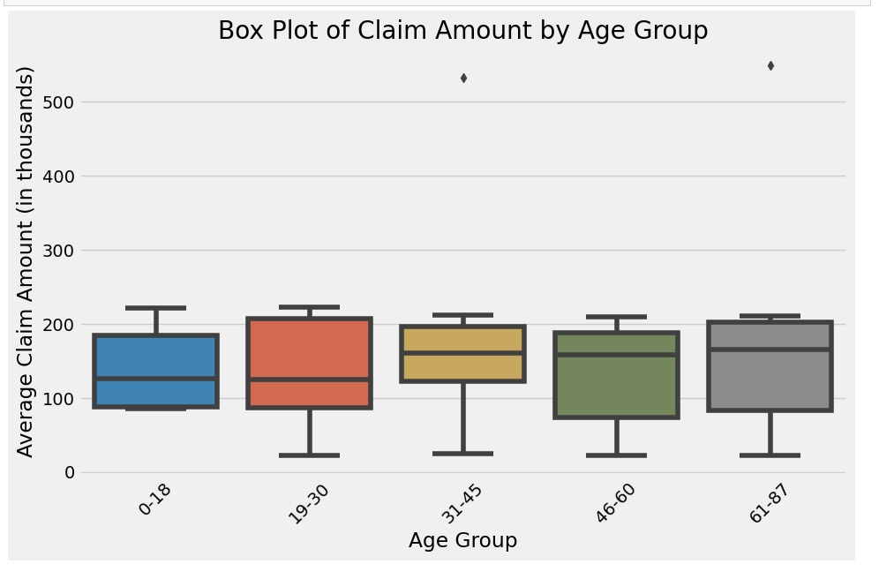
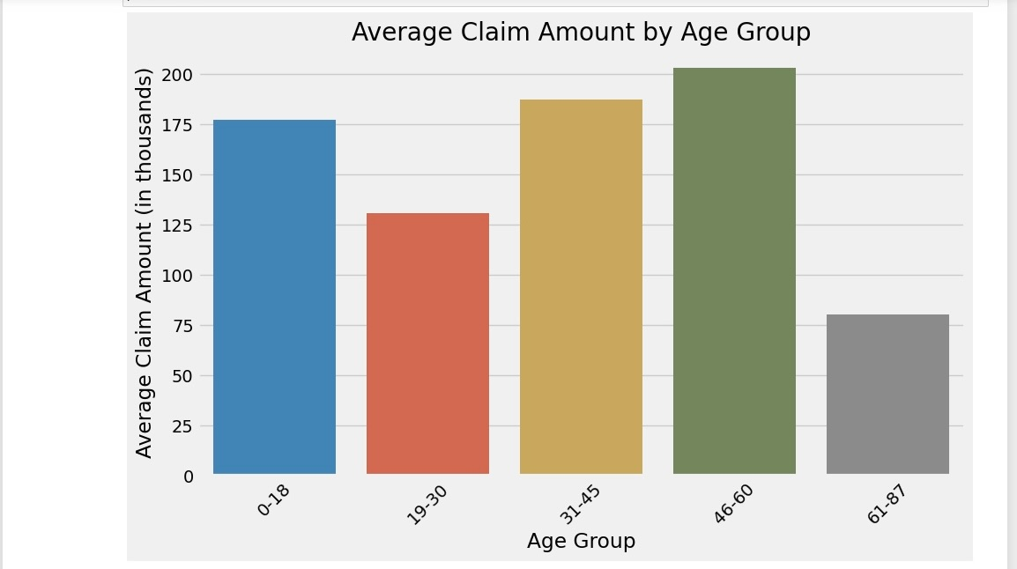

Slide 13
3. For which specialty is malpractice insurance most costly?
Our data indicates that Dermatology is the medical specialty associated with the highest malpractice insurance costs. This implies, on average, Dermatologists encounter greater claim amounts and expenses in malpractice insurance claims when compared to their counterparts in other medical specialties. To gain a more comprehensive understanding of the precise factors driving these heightened insurance expenses for Dermatology, further investigation is needed.

Slide 14
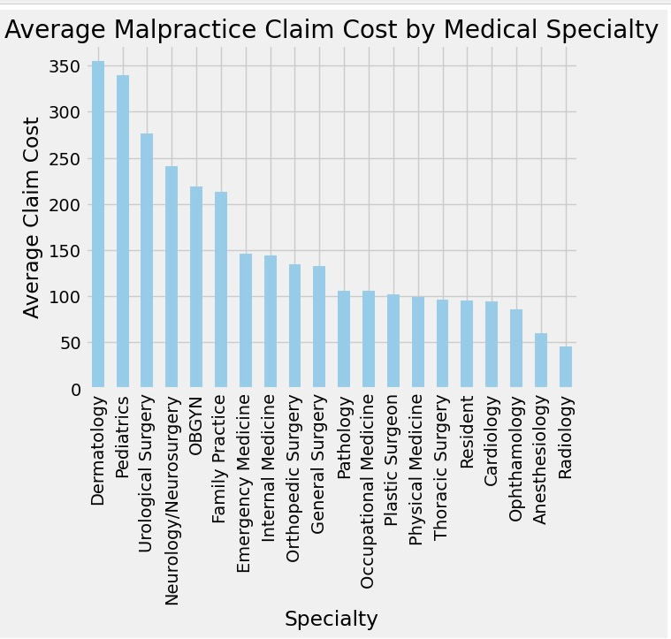
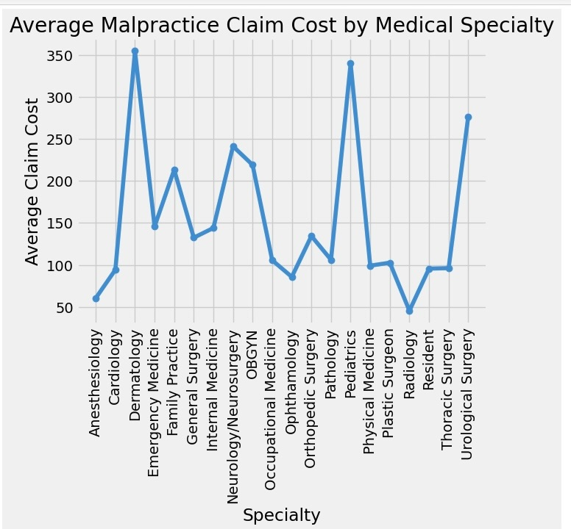

Slide 15
4. What impact does the choice of insurance have on the claim amount?
It is evident that there exists a substantial contrast in claim amounts based on the type of insurance. Specifically, Private Insurance stands out significantly in terms of the average amount when compared to other types. The analysis indicates that the selection of insurance type is a critical factor in influencing the claim amount. This insight can be helpful for decision-making concerning insurance coverage and effective claims management.

Slide 16
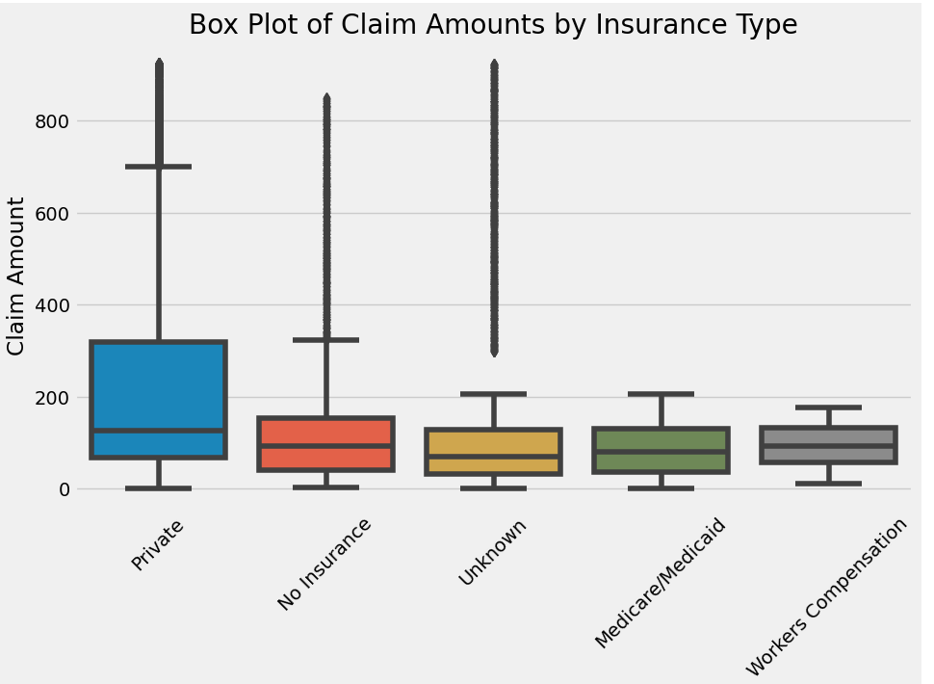
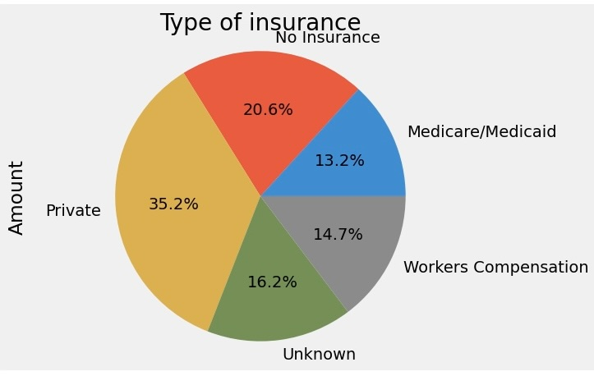

Slide 17
Conclusion:
In conclusion, the presence of a private attorney, the insured individual's age, the medical specialty, and the type of insurance coverage the patient holds all influence the cost of insurance claims. Hiring a private attorney in legal matters often leads to higher claim amounts. Private attorneys bring expertise and negotiation skills to the table, increasing the likelihood of securing larger settlements or judgments. Their involvement can result in more substantial compensation for the claimant.
The age of the insured individual can impact claim costs. Younger and older individuals may face different risk profiles. For example, younger individuals may be more prone to accidents, while older individuals may experience health-related claims. This variation in risk can lead to differences in claim amounts.
In the context of malpractice insurance, the medical specialty practiced by a healthcare professional is a significant factor. Based on our data, Dermatology specialty is linked to increased claim amounts in malpractice cases. This can be attributed to several factors such as complex procedures, cosmetic procedures, or high patient volume.
Lastly, the type of insurance coverage chosen by the policyholder plays a vital role in claim costs. Private insurance plans may offer broader coverage and higher limits, leading to higher claim amounts. Conversely, public or government-sponsored insurance programs may have limitations on claim payouts.

Slide 18

Questions?

